Slide 1

College of chemistry and chemical engineering
《English for Chemistry and Chemical Engineering》
Direction of Fine Chemicals
青岛大学 化学化工学院
杨晓龙

Slide 2
Main reference book
教材：邵荣，许伟，吕慧华编，新编化学化工专业英语（第二版），华东理工大学出版社，2017年
参考书：
1、张小军主编，化工专业英语，化学工业出版社，2017年
2、张裕平，姚树文，龚文君主编，化学化工专业英语（第二版），化学工业出版社，2017年
3、董坚主编，化学化工专业英语，浙江大学出版社，2016年
4、刘书志，乔德阳主编，制药专业英语，化学工业出版社，2016年
5、吴昊，乔德阳主编，生物化工与制药专业英语，化学工业出版社，2016年

Slide 3
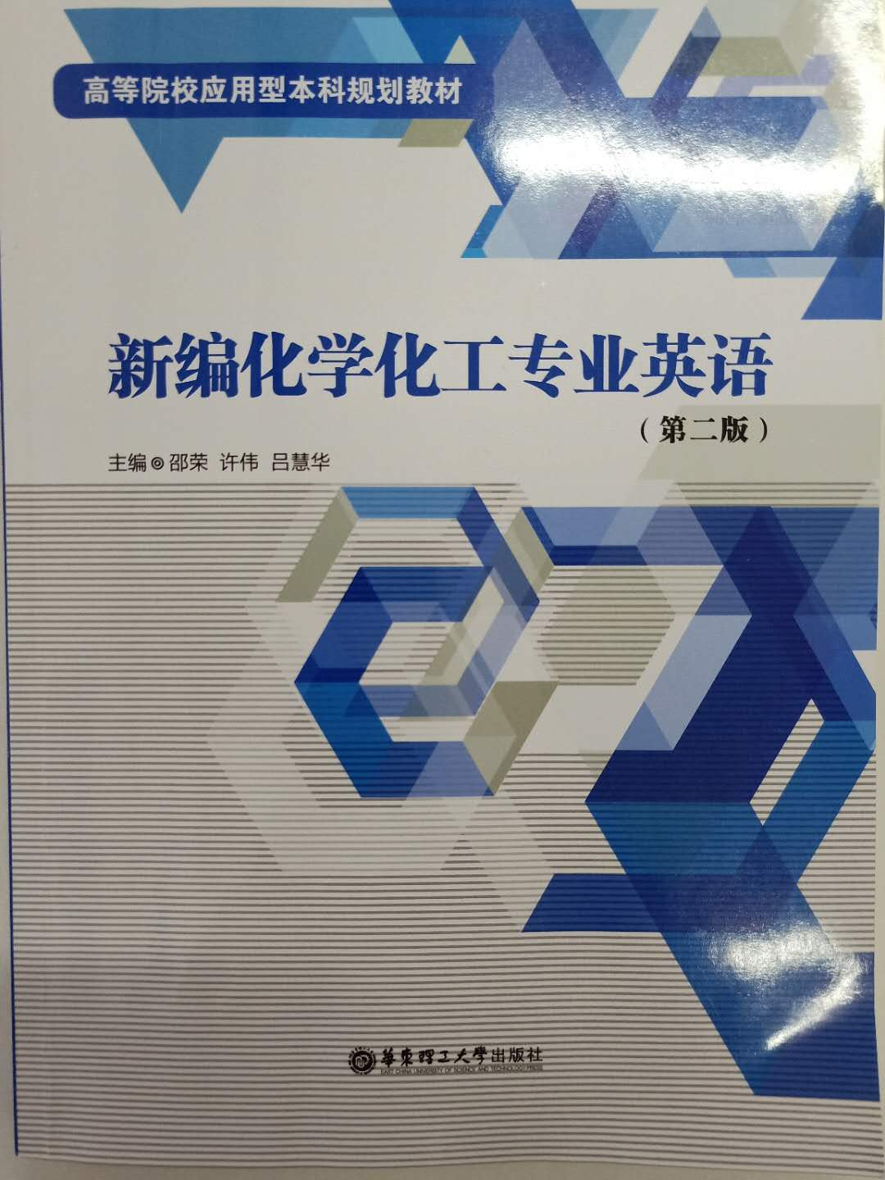
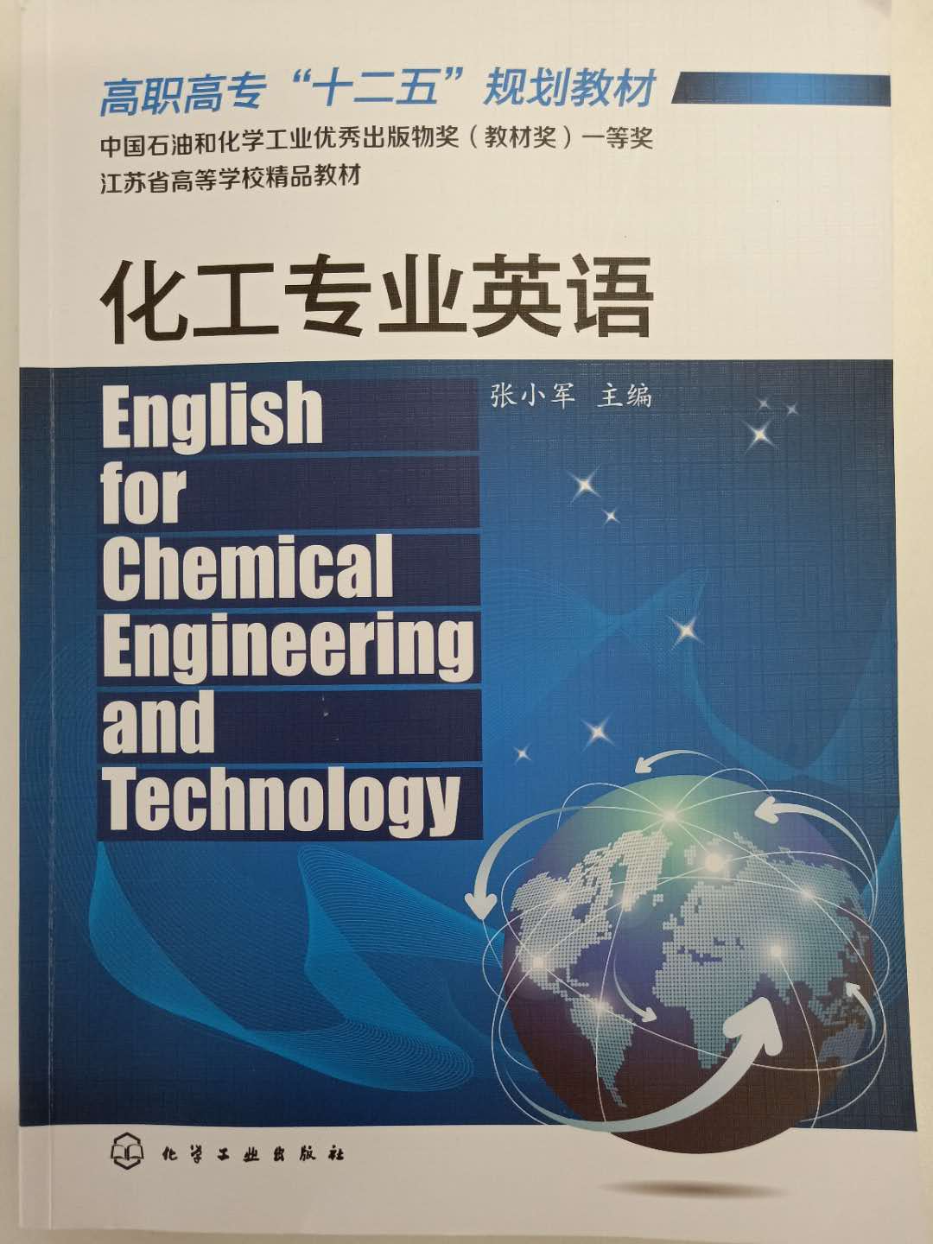
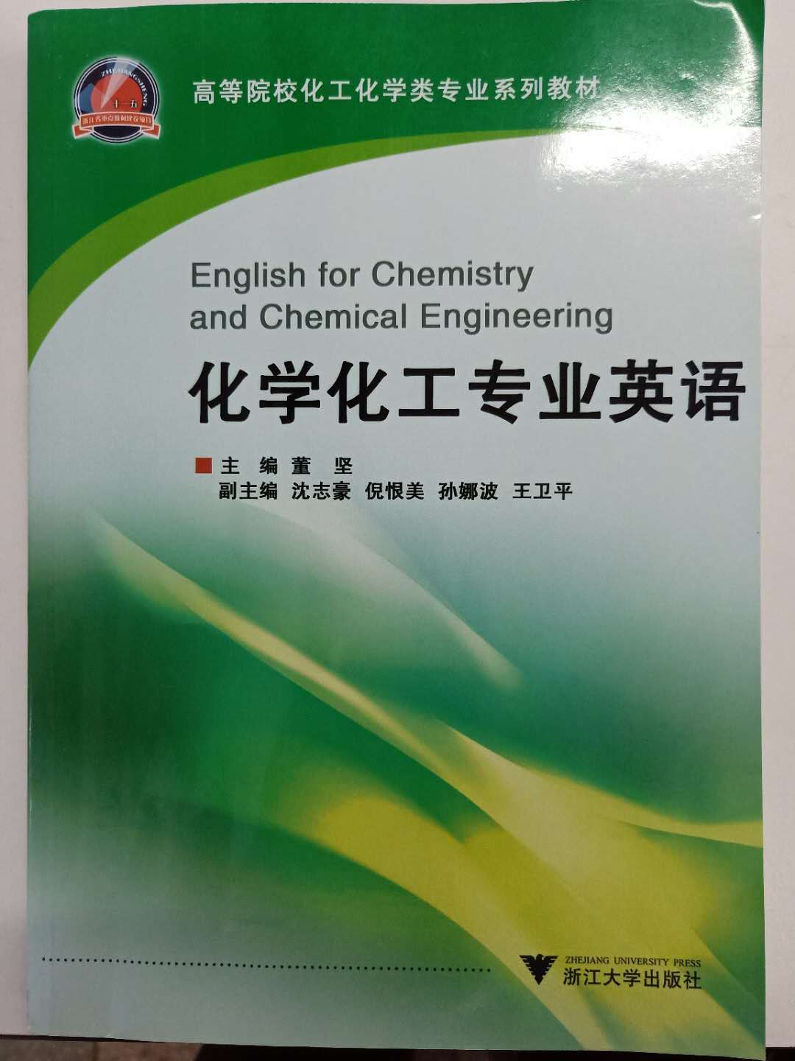
Main reference book

Slide 4
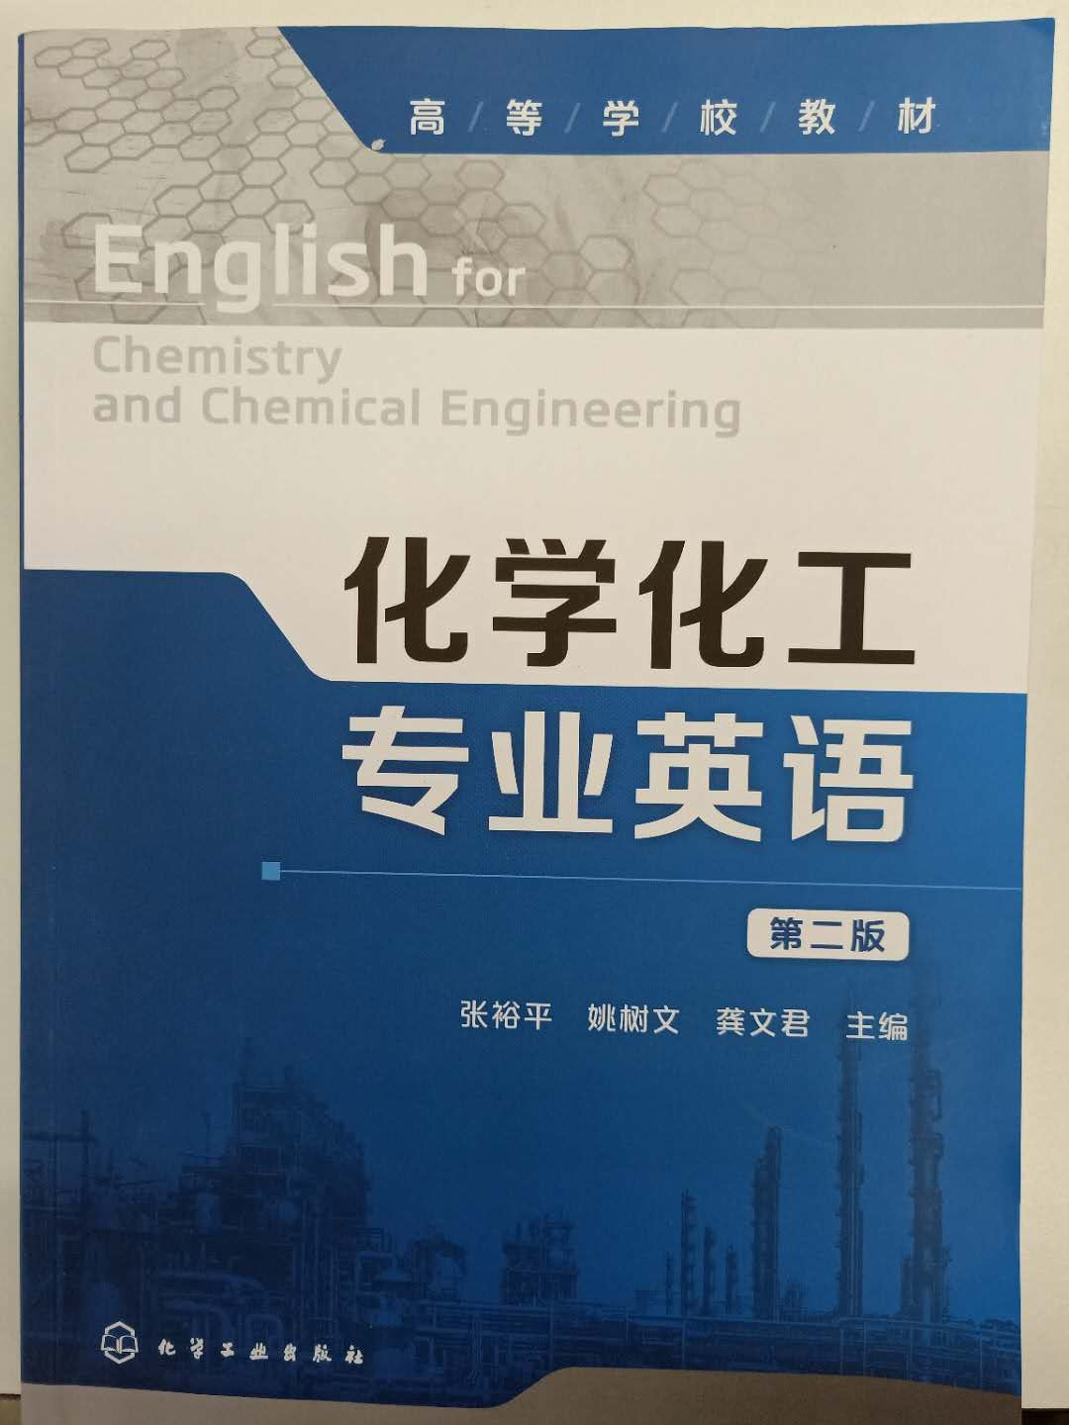
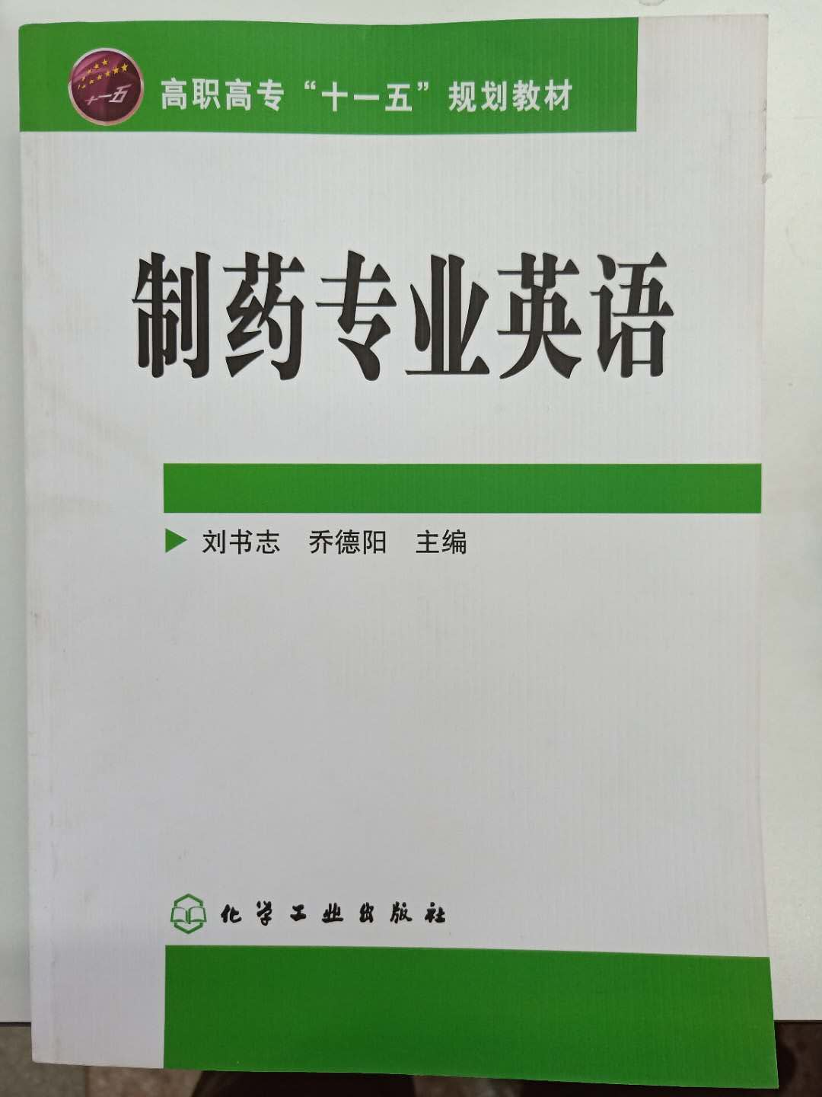
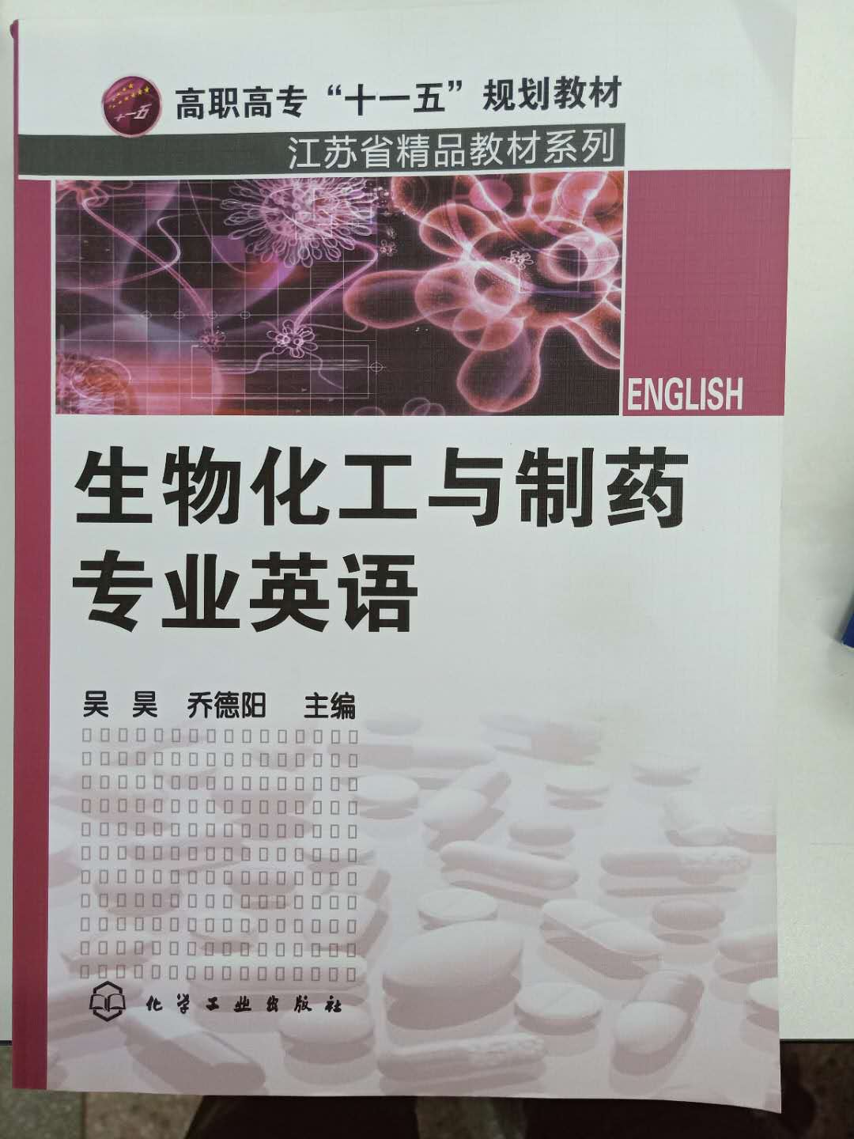
Main reference book

Slide 5
Main English reference journal
ACS Catal.
Angew. Chem. Int. Ed.
Applied Catalysis, B Environmental
Adv. Mater.
Chem
Chem. Eng. J.
Chem. Sci.
Chin. J. Catal.
Nat. Catal.
Small
Chemical reviews
Journal of the American Chemical Socienty(JACS)
Journal of Molecular Catalysis,A Chemical
Journal of Molecular Catalysis,B Enzymatic
Catalysis Communications
Catalysis Letters
Journal of Catalysis
Catalyst Review—Science and Engineering
Chemical Engineering Science

Slide 6
考查方式
期末考试：70%（闭卷考试）
平时成绩：30% （出勤/作业）

Slide 7

WHY YOU LEARN ENGLISH
1. 考研？专业+日常
2. 找工作？日常
3. 出国留学？日常+专业
All in all, excellent English level will undoubtedly have a tremendous impact on your career, which will make you stand out.
like a crane standing among chickens -- stand head and shoulders above others

Slide 8
Why do we learn Special English ?
研究生复试-笔试、口试
研究生阶段-：
英语文献检索、阅读、理解
英语报告的汇报、听说
英语讨论会、多媒体汇报
英语论文撰写、投稿、发表
GRE/IELTS考试出国留学

Slide 9
For examples:
1. Me, CET-4, CET-6, English speech prize, 免试推荐硕博连读
2. 硕士研究生录取亮点-英文水平
3. 好的英文水平会让研究生阶段更专一
4. 李灿院士课题组要求研究生过程中必须做一次英文工作汇报

Slide 10
章节 | 内容提要 | 学时分配
1 | 化工专业英语的特点 | 2
2 | 英语构词法 | 2
3 | 专业英语翻译 | 4
4 | 基础化学化工专业英语 | 4
5 | 化工单元操作 | 4
6 | 实验室装置和操作 | 4
7 | 无机化合物命名法 | 2
8 | 有机化合物命名法 | 4
9 | 精细化工阅读理解 | 4
10 | 拓展知识 | 2

Slide 11
Charpter. 1 Characteristic of ECCE
科技英语(English for Science and Technology)，EST是指用于自然科学与工程技术领域的一种英语文体。科技英语的特点主要体现在文体、时态、词汇、句式等几方面.
科学技术本身的性质要求专业英语( English for Special Science and Technology)与专业内容内容相互配合、相互一致，这就决定了专业英语与普通英语( Common English or General English or Ordinary English)具有很大差异。专业英语的主要特点是它具有很强的专业性，懂专业的人用起来得心应手，不懂专业的人用起来则困难重重。

Slide 12
就化工专业而言，由于历史的缘故，目前，国际上化工技术的交流主要是使用英语，70%以上的化工专业资料都是以英文形式写成的。因此，化工专业英语的学习与运用，对于化工专业技术人员介绍国内化工技术，吸收、消化国外先进的化工技术、参与化工技术交流是十分重要的。今天，我们一起开启“化工专业英语”的学习航程也是完全有必要的。

Slide 13
化工专业英语”( English for Chemical Engineering and Technology)是一门化工类专业必修课，其前修课程一般是公共英语和化工类专业技术课程，后修课程为化工专业双语课程和化工专业方向课程。该课程是以化工类专业内容和化工企业专业实践的视角，在公共英语、专业英语与双语教学课程这个连续化的“大英语”教学体系中，定位“化工专业英语”课程及其教学工作，它以化工工作过程为导向，以英语的专业应用能力为主线，以化工专业内容为载体，进行模块化课程教学改革，培养学生良好的化工专业领域工作过程的英语应用能カ，服务于化工专业工作实践，拓展职业生涯。

Slide 14
化学化工专业英语的学习目标
1.总体目标
通过《化工专业英语》课程的学习，将其作为专业生涯的工具之一，具备化工类中外资企业员工所需达到的英语应用能力的要求，能借助英语开展化工类专业领域的口语交流、工作过程应用起草、专业文献阅读与翻译工作，提升英语在化工领域的专门化应用能力，巩固和提高化工专业能力，运用英语开展化工专业实践工作和促进职业生涯的可持续发展。

Slide 15
拓展职业生涯
发展能力
化学化工专业英语
课程学习三角模型
核心
运用英语工作
专业能力
英语能力
巩固与提高
专门化与提升

Slide 16
2.具体目标
① 能与来化工企业合作的外方人员进行交流，并用英语介绍化工企业典型生产的产品、生产工艺、装置等(如，年产100t的均苯四甲酸二所产品 Pyromellitic Dianhydride，PMDA，及其氧化、水解、精制生产工段) 。
② 能运用化工专业英语常见词汇、语法、句型，汇报专业实践工作。

Slide 17
③ 能借助英汉化学化工字典、英汉翻译软件等工具，阅读和翻译国外英文化工专业资料(如:生产工艺流程说明、操作说明、设备说明书、维修指南、专利、企业标准)能将国内先进的化工生产工艺、产品等以英文的形式介绍给外方。
④ 能运用300个以上化工专业英语技术词汇( Technical Words)，500个以上化工专业英语次技术词汇(Sub- technical Words)写化工专业工作过程的检验报告、安全生产记录、合同、产品简介等工作应用文。

Slide 18
3.其他目标
a. 英文专业沟通能力；
b. 化工文献阅读能力；
c. 化工文章写作能力；

Slide 19
我们在化工专业实践过程中除需要书面交流以外，很多时候我们还需要口语交流。在口语交流时，首先要掌握常用的日常英语口语；其次，注重积累化工专业词汇和次专业词汇，
如，“ Composition”在普通英语中是作文之意而在化工专业英语中是“成分”的含义，同样“ Level”在化工上表示“液位”，“ Critical”是指“临界(温度)”等；再次，还应该注意英语口头交流的一些基本技巧和其他有关文化方面的问题，强化基本的英语口语技巧以及化工专业实践口语训练。

Slide 20
第一，多学习、多交流、多积累。注意化工专业英语的有效单词量和习语积累。积累中不仅要记住单词的读音、拼写、中文语义，更重要的是它所使用的语境、用法、传达的信息等。同时不要单纯地死背单词，一定要放在上下文语境中记忆，能够让人事半功倍，在这方面可以通过多查阅国外化工类英文网站进行训练。“说”很重要。多看些外国电影或者多听英文录音，练习自己的听力，也可以尽量模仿电影。

Slide 21
第二，灵活运用多渠道表达的方法。人与人之间交谈80%是想告诉对方这个事物是什么。如果一种表达式对方不懂，可以寻找另一种表达式最终让对方明白。因为事物就一个，但表达它的语言符号可能会很多。也就是说用一种不同的方式表达同一个意思，或者一个表达式对方听不清楚，举一个简单易懂的例子来表达，直到对方明白。

Slide 22
例如，你想告诉对方你今天中午吃了什么东西，但是不知道中午吃的这些菜品如何翻译为英文(对于中餐来说这种情况非常常见)，那你完全可以通过描述这品菜用了哪些材料，如何制作，通过简短的描述就能让对方理解你的意思。
Kung Pao Chicken Sweet and Sour Spare Ribs
Sautéed Shredded Pork with Green Pepper
Stewed chicken with mushroom
Bean Sauce Tofu Sweet-and-sour carp
West Lake Beef Soup Mar-Boh Tofu

Slide 23
第三，不要怕犯错，尽量多开口交流。只要不是在法庭上这种一句话都不能说错的场合，日常的口语交流犯犯错没有什么大不了的。很多同学日常说话是怕犯错，怕听不懂，怕用错语法，其实大可不必。即使是母语是英语的人，平时说话也难免犯些小错误，平时互相交流有时一两句话没听清也是常事，不必过度在意。没听清对方的说话，只要礼貌地请对方重复遍就行。一些小的不影响表达的小语法错误也不会让对方听不懂你的说话。只要大着胆子，多说，多交流，假以时日，口语能力一定会进步。

Slide 24
Charpter. 1 Characteristic of ECCE
1.文体
科技英语力求平易、客观和精确，避免行文晦涩、表露感情、刻意修辞等。行文时陈述句多，感叹句、疑问句少。例如:
Since 1940 the chemical industry has grown at a remarkable rate. The lion's share of this growth has been in the organic chemicals sector due to the development and growth of the petrochemicals area since 1950. The explosive growth in petrochemicals in the1960s and 1970s was largely due to the enormous increase in demand for synthetic polymers such as polyethylene, polypropylene, nylon, polyesters and epoxy resins.

Slide 25
Since 1940 the chemical industry has grown at a remarkable rate.
The lion's share of this growth has been in the organic chemicals sector due to the development and growth of the petrochemicals area since 1950.
自1940年以来，化学工业以惊人的速度增长。
由于1950年以来石化产品的迅猛发展，这其中增长的最大一部分在于有机化学品（领域）。

Slide 26
The explosive growth in petrochemicals in the 1960s and 1970s was largely due to the enormous increase in demand for synthetic polymers such as polyethylene, polypropylene, nylon, polyesters and epoxy resins
20世纪60年代和70年代石化产品的爆炸式增长主要是由于对合成聚合物需求的大幅增长，如聚乙烯，聚丙烯，尼龙，聚酯和环氧树脂等。

Slide 27
The lion's share
这个词现在的意思和狮子没有什么关系,它经常出现在一些分析报告中,如：
As usual, the lion's share of the budget is for defence.
“如往常一样,预算中的最大一项照例是国防费用.”
the lion's share意思就是“最大或最好的一份”. 典故-《伊索寓言》,故事中狮子将其他所有动物的猎物都攫为己有.所以现在人们就用它来形容份额最大的一部分.

Slide 28
The lion's share of the responsibility for getting things done fell on my shoulders.
把事情干完的大部分责任落在我的肩上.
Military and nuclear research have received the lion's share of public funding.
大部分公共资金都为军事与核研究所占。

Slide 29
sector [ˈsɛktɚ, -ˌtɔr] （尤指一国经济的）部门，领域，行业
petrochemicals [ˌpetroʊ'kemɪkəlz] 石化
polymers ['pɒlɪməs] 聚合物
polyethylene [ˌpɑ:liˈeθəli:n] 聚乙烯
polypropylene [ˌpɑ:liˈproʊpəli:n] 聚丙烯
nylon [ˈnaɪlɑ:n] 尼龙
polyesters ['pɒlɪˌestəz] 聚酯
epoxy [ɪˈpɑ:ksi] 环氧
resins ['rezɪnz] 树脂

Slide 30
科技论文作者在说明事理、提出设想、探讨问题和推导公式时，常常涉及各种前提、条件和场合。为了避免武断，保持谦虚或谨慎的态度，经常使用虚拟语气，使口吻变得委婉。例如
If a pound of sand were broken up and turned into atomic energy, there would be enough power to supply the whole of Europe for a few years.
如果一磅沙子裂变，放出(所有)原子能，那将够整个欧洲用几年。

Slide 31
在说明注意事项时，则常常使用祈使句。例如:
Be careful not to mix the liquids
注意!不要把这几种液体混起来。

Slide 32
另外，科技英语的表达方式较为程式化。科技文章往往由标题、摘要、关键词、正文、参考文献等部分构成(视具体情况，可以有其中的几种或全部)。正文一般又分为引言、论述与结论三个部分。在引言部分说明文章的主题和有关背景等。在论述部分对文章主题按一定次序展开叙述和讨论。如果是介绍实验成果的文章，则首先介绍实验仪器与设备、实验参数、实验过程和实验结果，然后展开讨论。在结论部分则根据前面的讨论与推理，作出总结或提出建议。

Slide 33
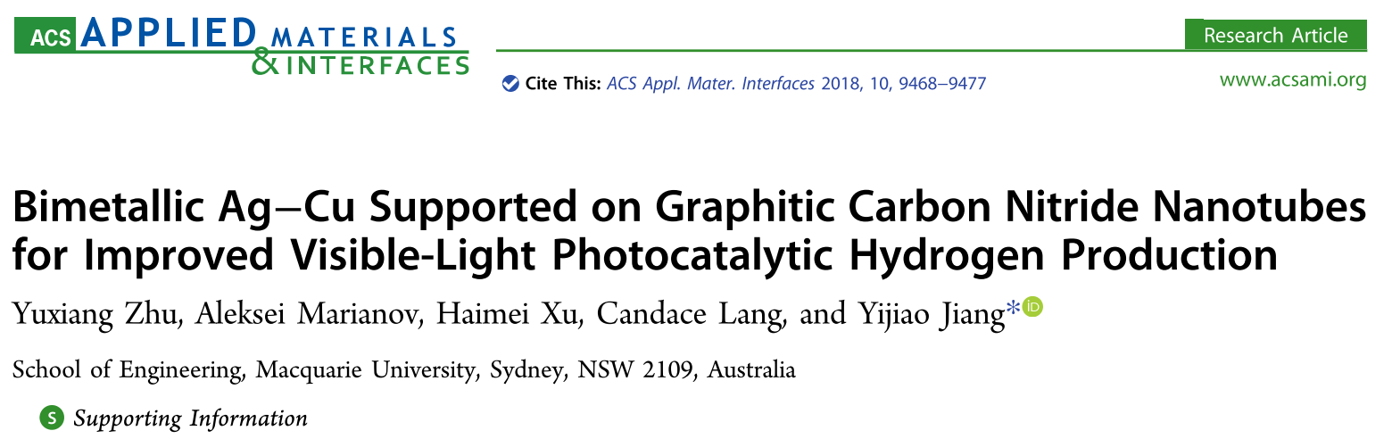
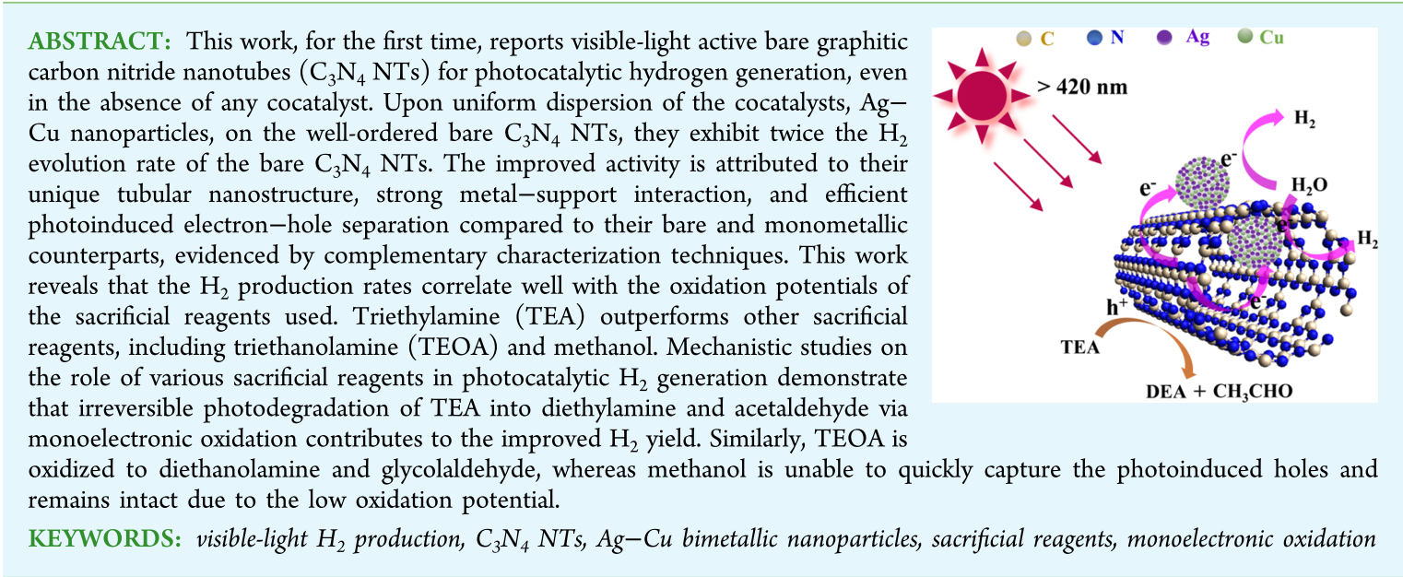

Slide 34
ABSTRACT: This work, for the first time, reports visible-light active bare graphitic carbon nitride nanotubes (C₃N₄ NTs) for photocatalytic hydrogen generation, even in the absence of any cocatalyst. Upon uniform dispersion of the cocatalysts, Ag−Cu nanoparticles, on the well-ordered bare C₃N₄ NTs, they exhibit twice the H₂ evolution rate of the bare C₃N₄ NTs. The improved activity is attributed to their unique tubular nanostructure, strong metal−support interaction, and efficient photoinduced electron−hole separation compared to their bare and monometallic counterparts, evidenced by complementary characterization techniques.

Slide 35
This work reveals that the H₂ production rates correlate well with the oxidation potentials of the sacrificial reagents used. Triethylamine (TEA) outperforms other sacrificial reagents, including triethanolamine (TEOA) and methanol. Mechanistic studies on the role of various sacrificial reagents in photocatalytic H₂ generation demonstrate that irreversible photodegradation of TEA into diethylamine and acetaldehyde via monoelectronic oxidation contributes to the improved H₂ yield. Similarly, TEOA is oxidized to diethanolamine and glycolaldehyde, whereas methanol is unable to quickly capture the photoinduced holes and remains intact due to the low oxidation potential.

Slide 36
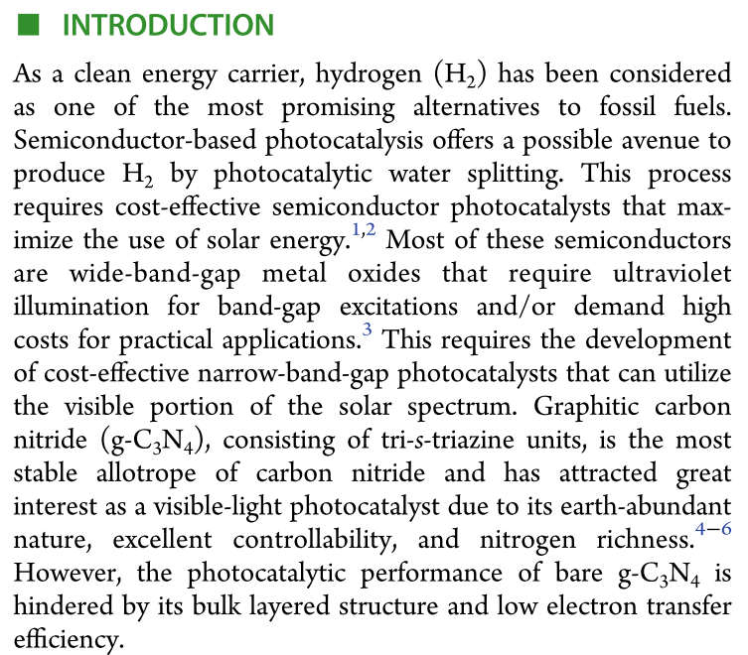

Slide 37
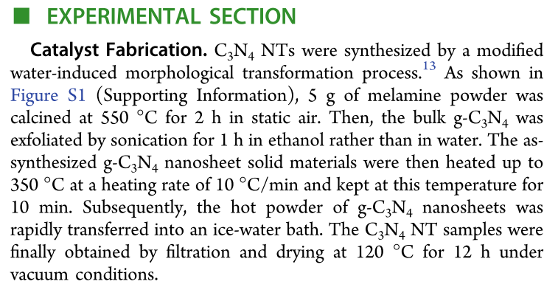

Slide 38
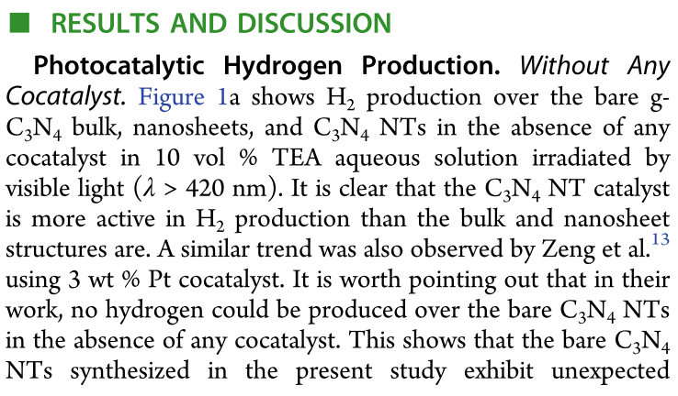

Slide 39
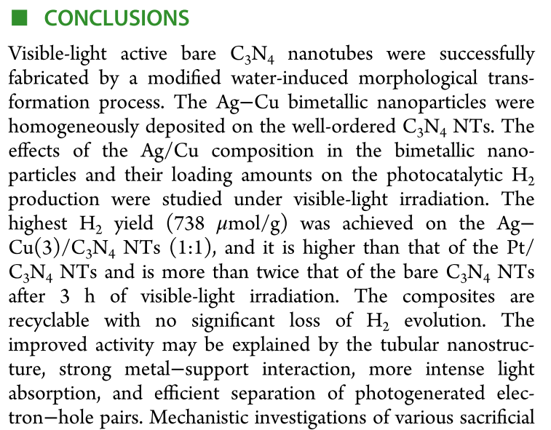

Slide 40
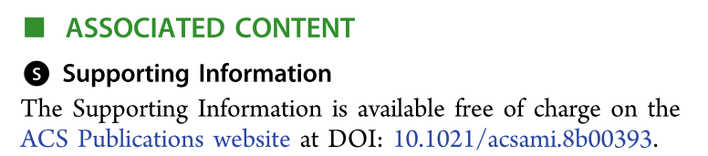
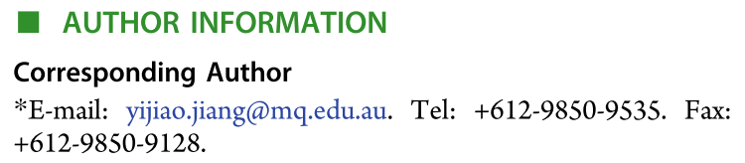
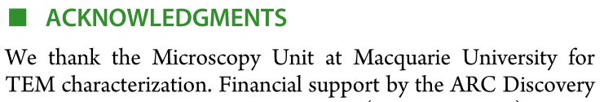
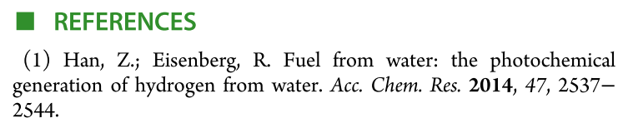

Slide 41
2.时态
科技英语行文时，时态运用有限。叙述过去的研究常用过去时，间或也用现在完成时；论述理论部分用现在时，尤其常用一般现在时，以表述无时间性的科学事实或规律等。例如
is
The chemical industry ( ) concerned with converting raw materials, such as crude oil firstly into chemical intermediates, and then into a tremendous variety of other chemicals. These ( ) then used to produce consumer products, which make our lives more
are

Slide 42
comfortable, or produce some products, such as pharmaceutical products, to help maintain our well-being or even life itself. At each stage of these operations some value ( ) added to the product, and if the added value ( ) the costs of raw material plus processing, a profit ( ) made on the operation. It ( ) the aim of the chemical industry to achieve this.
is
exceeds
will be
is
除上述时态外，有时还用将来时、进行时，偶尔也用过去完成时。

Slide 43
The chemical industry ( is ) concerned with converting raw materials, such as crude oil firstly into chemical intermediates, and then into a tremendous variety of other chemicals. These ( are ) then used to produce consumer products, which make our lives more comfortable, or produce some products, such as pharmaceutical products, to help maintain our well-being or even life itself. At each stage of these operations some value ( is ) added to the product, and if the added value (exceeds) the costs of raw material plus processing, a profit (will be) made on the operation. It (is) the aim of the chemical industry to achieve this.
化学工业将原油等原材料首先转化成化学中间体，继而转化成各种其他化学品。这些化学品被用来生产使我们的生活更舒适的消费品，或者生产一些医药产品，以帮助维持我们的身体健康甚至生活本身。在这些操作的每个阶段，都有一些附加值添加到产品中，如果附加值超过原材料和加工成本之和，则在操作上获得利润。这是化学工业实现这一目标的目的所在。

Slide 44
is
The full-spectrum photocatalytst ( ) of important value for the practical use, which could absorb natural sunlight for photoctalytic degrading organic pollutants. BiPO₄/Bi₂WO₆ composite photocatalysts ( ) prepared via ultrasonic-calcination method and ( ) superior photocatalytic performance for degrading different kinds of organic pollutants under simulant sunlight irradiation.
were
had
have had are were is was
A B C D E F

Slide 45
The apparent rate constant of 5.0%BiPO₄/Bi₂WO₆ on the degradation of methylene blue (MB) ( ) 0.0305 min⁻¹, which ( ) about 25.4 and 3.2 times of pure BiPO₄ and Bi₂WO₆ respectively. In the BiPO₄/Bi₂WO₆ composite photocatalysts, the core-hole structure of BiPO₄ as core and Bi₂WO₆ as hole ( ) formed.
is
is
was
have had are were is was
A B C D E F

Slide 46
During the photocatalytic process of BiPO₄/Bi₂WO₆ composites under simulant sunlight irradiation, the photo-generated electrons of BiPO₄ () inject to the conduction band of Bi₂WO₆, and the photo-generated holes on Bi₂WO₆ () transfer to the valance band of BiPO₄, and then an effective charges separation () achieved.
would
could
was
can be
could
may be
was
are were
A B C D E F
would
is
G H

Slide 47
The interaction of BiPO₄ and Bi₂WO₆ not only ( ) the range of absorption spectrum but also ( ) the separation efficiency of photo-generated charges, and further ( ) the photocatalytic performance.
expanded
enhanced
improved
expand (expands expanding expanded
was expanded、 had been expanded)
enhance
improve

Slide 48
3.词汇
科技英语大量使用专业词汇，经常利用前缀、后缀构成派生词，并大量使用缩略词。
与元素周期表相关的名词
镧系元素
锕系元素
碱金属
碱土金属
周期表中的族
卤素
lanthanoid
主族元素
准金属/半金属
惰性气体
非金属元素
main group elements
metalloids
or semimetals
actinide
alkali metal
noble gases
nonmetals
alkaline earth metals
family
halogen

Slide 49
原子序数 - Atomic Number
质子数 - Proton Number
电荷数 - Charge Number
相对原子质量 - Relative Atomic Mass
标准原子量 - Standard Atomic Weight
电离能 - Ionisation Energy / Ionization Energy (英式/美式英语拼写不同)
电子亲合能 - Electron Affinity
电负性 - Electronegativity
基态 - Ground State 激发态 Excited state
化合价 - Valance Number
氧化数 - Oxidation Number
半衰期 - Half-Life

Slide 50
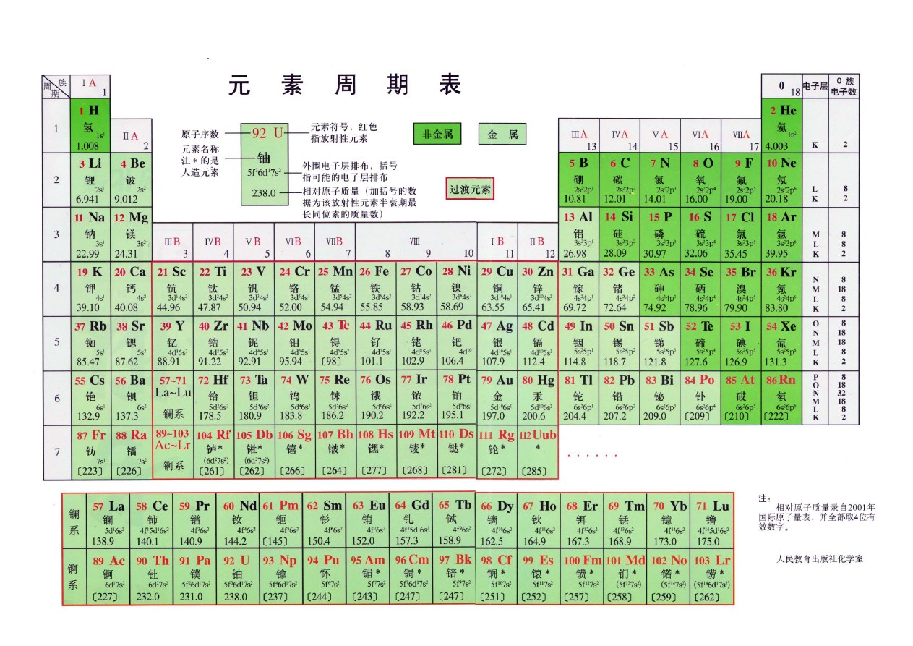
alkali metal
The Periodic Table
group
halogens
noble gas
alkaline earth metal
inert gas
period
lanthanoid
actinide

Slide 51
Group IVA consists of a nonmetal, carbon, two metalloids, silicon and germanium, and two metals，tin and lead．
IVA由非金属元素C、两种准金属元素Si和Ge、两种金属元素Sn和Pb组成。
Each of these elements forms some compounds with formulas which indicate that four other atoms are present per group IVA atom, as, for example, carbon tetrachloride, CCl₄.
IVA每一种元素都形成一些这样的化合物，它们的分子式指出有四个其它的原子存在于IVA原子周围（或四个其它的原子与IVA原子结合），如四氯化碳CCl₄。

Slide 52
These elements do form compounds-nitrides，phosphides，and arsenides—in which ions having charges of minus three occur.
这些元素确实形成氧化数为-3氮化物、磷化物和砷化物。
The elements of group VB are all metals．
VB族元素都是金属元素。
These elements form such a variety of different compounds that their characteristics are not easily generalized.
这些元素形成如此种类繁多的化合物以至于很难概括出它们的特征。

Slide 53
Successive elements along the period show decreasing metallic character, eventually becoming nonmetals, and finally, in group VIIA, a very reactive nonmetal is found.
同一周期随着原子序数的增加，元素的金属性减弱，最终成为非金属，最后，在第七主族，出现了活泼的非金属元素。
Each period ends with a member of the noble gas family.
每一周期都以惰性气体家族成员结束。

Slide 54
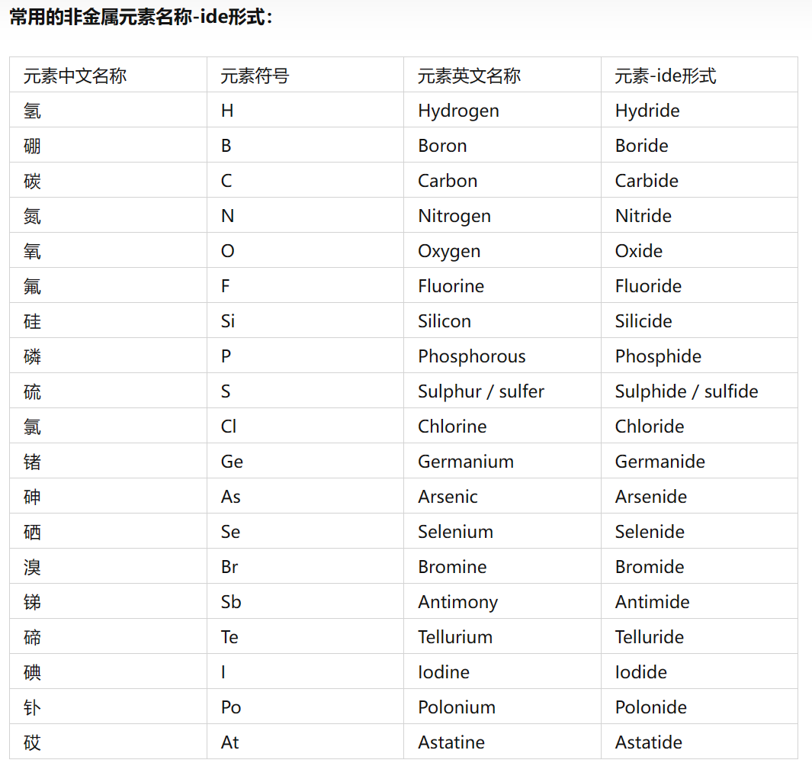

Slide 55
1. Atomic structure
Matter has mass and takes up space, Atoms are basic building blocks of matter, and cannot be chemically subdivided by ordinary means. Atoms are composed of three types of particles: protons, neutrons, and electrons. Protons and neutrons are responsible for most of the atomic mass. The mass of an electron is very small.
Both protons and neutrons reside in the nucleus. Protons have a positive charge (+), neutrons have no charge-they are neutral. Electrons reside in orbitals around the nucleus. They have a negative charge(-).
It is the number of protons that determines the atomic number. The number of protons in an element is constant but the number of neutrons may vary, so mass number (protons+ neutrons) may vary.

Slide 56



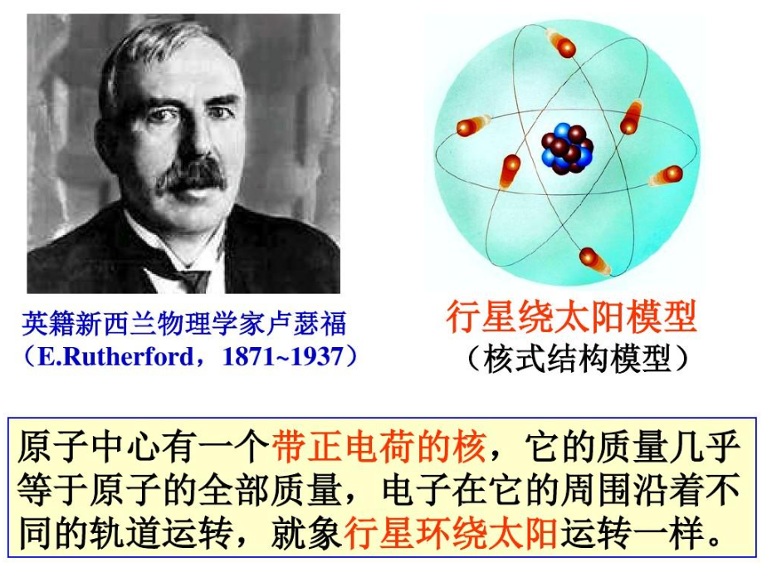
Electron Shells
Proton
Neutron
Electron

Slide 57
1. Atomic structure
The same element may contain various numbers of neutrons; these forms of an element are called isotopes. The chemical properties of isotopes are the same, although the physical properties of some isotopes may be different. Some isotopes are radioactive, which means they "radiate" energy as they decay to a more stable form, perhaps another element half-life (time required for half of the atoms of an element to decay into stable form). Take oxygen for example. Its atomic number of 8 can have 8, 9 or 10 neutrons.
Here is a list of the basic characteristics of atoms:
1. An atom is a basic chemical building block of matter. Atoms cannot be divided using chemicals, but they do consist of three parts, which include protons, neutrons and electrons.
2. Each electron has a negative electrical charge.

Slide 58
1. Atomic structure
3. Each proton has a positive electrical charge. The charge of a proton and an electron are equal in magnitude, yet opposite in sign. Electrons and protons are electrically attracted to each other.
4. Each neutron is electrically neutral. In other words, neutrons do not have a charge and are not electrically attracted to either electrons or protons.
5. Protons and neutrons are about the same size as each other and are much larger than electrons. The mass of a proton is essentially the same as that of a neutron. The mass of a proton is 1840 times greater than the mass of an electron.
6. The nucleus of an atom contains protons and neutrons, The nucleus carries a positive charge.
7. Electrons move around the nucleus.

Slide 59
1. Atomic structure
8. Almost all mass of an atom is in its nucleus; almost all volume of an atom is occupied by electrons.
9. The number of protons (also known as its atomic number) determines the element. Varying the number of neutrons results in isotopes. Varying the number of electrons results in ions. Isotopes and ions of an atom with a constant number of protons are variations of a single element.
10. The particles within an atom are bound together by powerful forces. In general, electrons are easier to add or remove from an atom than a proton or neutron. Chemical reactions largely involve atoms or groups of atoms and interactions between their electrons.

Slide 60
构词法也就是词的构成方法，即词在结构上的规律.
例如: tetracycline
all-weather
antiaging
四环素(tetra-“四”，cycl(ic))“环”，-ine某ー类化学物质)
适应各种气候的，全天候的(al与 weather间加连字符)
防衰老的(anti与 aging间不加连字符)

Slide 61
mascon
gravimeter
lab 实验室(截取 laboratory前3个字母)
XRD
SEM
质量密集的物质(mass与 concentration两词各取前3个字母)
比重计( gravity的前4个字母与 meter合成)
X射线行射(由 X-ray Diffraction缩略而成)
扫描电子显徽镜(由 scanning electron microscope缩略而成)

Slide 62
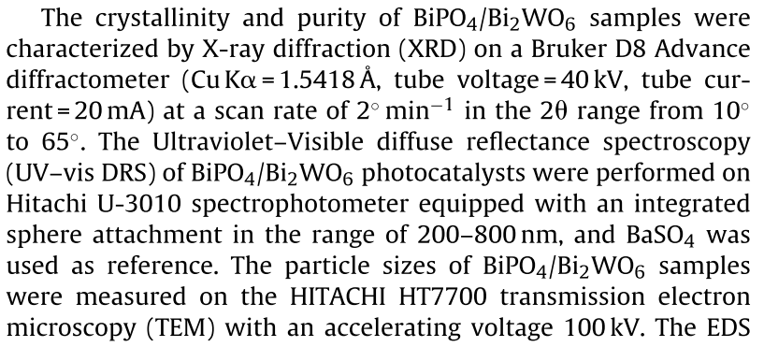

Slide 63
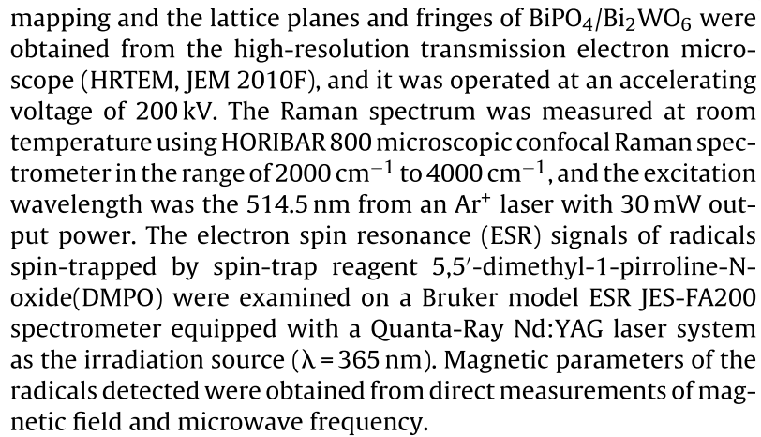

Slide 64
4.句子
科技英语多使用长句和被动句，大量使用名词化结构( nominalization)和非限定动词，还经常使用后置定语。
(1)长句
为了表述一个复杂概念，使之逻辑严密，科技文章中往往出现许多长句。有的句子甚至多达七八十个词。

Slide 65
Petrochemical Industry-Petroleum Refinery Distillation
A petroleum refinery is an installation that manufactures finished petroleum products from crude oil, natural gas liquids, and other hydrocarbons. Refined petroleum products include but are not limited to gasolines, kerosene, distillate fuel oils, liquefied petroleum gas, asphalt, lubricating oils, diesel fuels, and residual fuels.
炼油厂是一个用原油、液化天然气和其他碳氢化合物生产成品油的装置。精炼石油产品包括但不限于汽油、煤油、馏出燃料油、液化石油气、沥青、润滑油、柴油和残余燃料。

Slide 66
(2)被动句
科技人员在研究和解决科技问题时尊重客观，重视事实和方法，性能和特征、规律和推理。因此，使用第一人称会给读者造成作者主观臆断的印象，使用第二人称则会使读者产生主观性。正因为这样，在科技文献中通常主要是使用非人称(无生命第三人称)的语气进行客观叙述，从而也较多使用被动句。被动语态数量之多，可以占到全部谓语动词的1/3到1/2以上。此外，科技文章将主要信息前置，放在主语部分，从而使句子更为简短、紧凑，使行文更加准确、严谨和精练，这也是广泛使用被动语态的主要原因。

Slide 67
例如:
A bubble tower is used to distil petroleum.
蒸馏石油时使用鼓泡塔。
而不说:
We use a bubble tower to distil petroleum
我们用鼓泡塔蒸馆石油。

Slide 68
(3)名词化结构
名词化( nominalization)是指词性作用的名词性转换，包括起名词作用的非谓语动词和
与动词同根或同形的名词，也包括一些形容词来源的名词。名词化既可起名词的作用,也可以表达谓语动词或形容词所表达的内容，常伴有修饰成分或附加成分，构成短语。因此，句法上小到词或词组，大到句子段落,都可以进行名词化处理，从而形成组合方式的名词化短语。

Slide 69
名词化结构既可使行文简洁、表达客观、内容确切，也可使所含信息量增大。科技英语
常强调存在的事实并非个别行为或现象，故名词化结构尤为常见。
The shrinkage of the sun to this state would transform our oceans into ice and our atmosphere into liquid air.
如果太阳收缩到这种状态，就会把海洋变成冰，把大气变为液化气.

Slide 70
(4)非谓语动词 (非限定动词)
在科技作品中，人们往往要说明各个事物之间的关系，事物的位置和状态变化。如机器、产品、原料等的运动、来源、形式，产品的加工手段、工艺流程和仪器、设备的操作方法，这些都要求叙述严谨、准确。运用动词的非谓语形式容易实现这些要求，而且能用扩展的成分对所修饰的词进行严格的说明和限定。每一个分词短语都能代替一个从句，因此可以完整、准确地表达某一概念和事物，同时保证行文简练、结构紧凑。

Slide 71
科技文章要求行文简练、结构紧凑。为此，往往使用
分词短语代替定语从句或状语从句；
分词独立结构代替状语从句或并列分句；
不定式短语代替各种从句；
介词+动名词短语代替定语从句或状语从句。
这样既可缩短句子，又比较醒目。

Slide 72
Even confined in a rigid container, gas will expand at high temperature.
气体即使封闭在刚性容器中，在高温下也会膨胀。
Annealing is one of the heat treatments of steel.
退火是钢的热处理(方法)中的一种。

Slide 73
Radiating from the earth, heat causes air currents to rise.
热量由地球辐射出来，并使得气流上升。
There are different ways of changing energy from one form into another.
将能量从一种形式转变成另一种形式有各种不同的方法。

Slide 74
(5)后置定语
大量使用后置定语也是科技文章的特点之一。例如:
As a ship is loaded, it sinks deeper into the water, displacing an additional amount of water equal to the weight of the added load.
船装了货物吃水更深，其排开的附加水量等于所装货物的重量。
The forces due to friction are called frictional forces.
由于摩擦而产生的力称之为摩擦力。

Slide 75
Petrochemical Industry-Petroleum Refinery Distillation
A petroleum refinery is an installation that manufactures finished petroleum products from crude oil, natural gas liquids, and other hydrocarbons. Refined petroleum products include but are not limited to gasolines, kerosene, distillate fuel oils, liquefied petroleum gas, asphalt, lubricating oils, diesel fuels, and residual fuels.
炼油厂是一个用原油、液化天然气和其他碳氢化合物生产成品油的装置。精炼石油产品包括但不限于汽油、煤油、馏出燃料油、液化石油气、沥青、润滑油、柴油和残余燃料。

Slide 76
The core refining process is simple distillation (Fig. 2-1). Because crude oil is made up of a mixture of hydrocarbons, this first and basic refining process is aimed at separating the crude oil into its "fractions," the broad categories of its component hydrocarbons. Crude oil is heated and put into a still--a distillation column--and different products boil off and can be recovered at different temperatures.
核心精炼过程为简单蒸馏（图2-1）。由于原油是由碳氢化合物的混合物组成的，这第一个也是基本的精炼过程旨在将原油分离成其“馏分”，即其组成碳氢化合物的大类。原油被加热后放入精馏塔，不同的产品在不同的温度下沸腾并被回收。

Slide 77
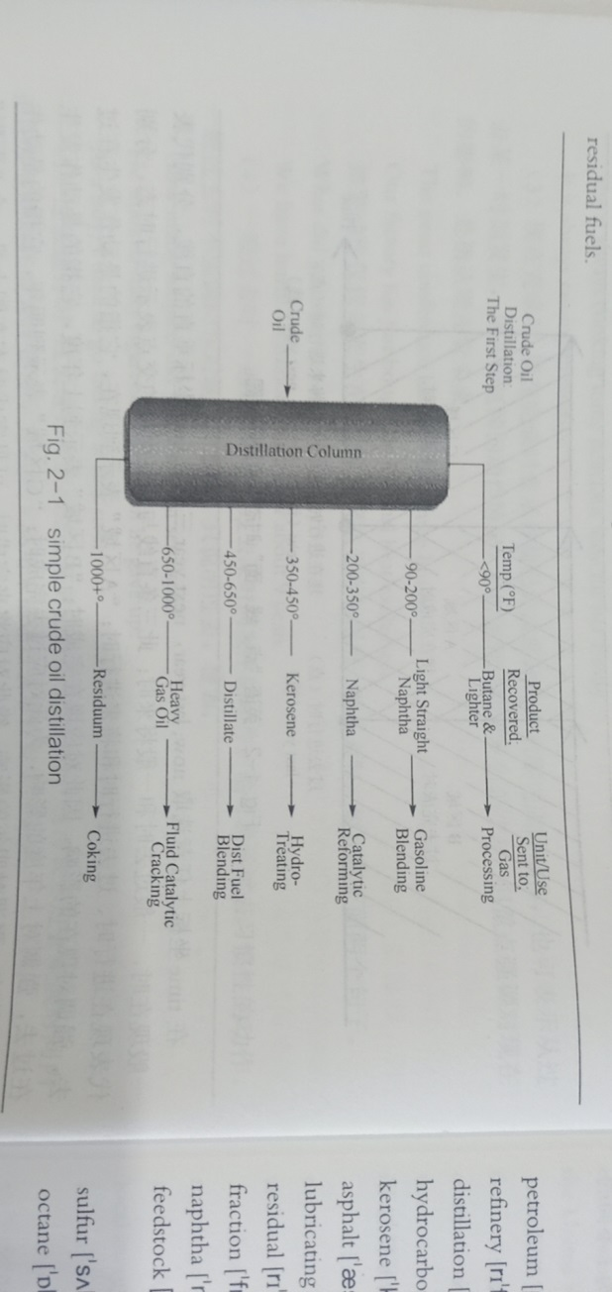

Slide 78
The lighter products-liquid petroleum gases (LPG), naphtha, and so-called "straight run" gasoline-are recovered at the lowest temperatures. Middle distillates-jet fuel, kerosene, distillates (such as home heating oil and diesel fuel)-come next. Finally, the heaviest products (residuum or residual fuel oil) are recovered, sometimes at temperatures over 1000 degrees F. The simplest refineries stop at this point. Other refineries reprocess the heavier fractions into lighter products to maximize the output of the most desirable products.

Slide 79
轻质产品-液化石油气（LPG）、石脑油和所谓的“直馏”汽油在最低温度下回收。然后是中间馏分航空燃油、煤油、馏分（如家用取暖油和柴油）。最后，回收最重的产品（残渣或残余燃油），有时温度超过1000华氏度。最简单的炼油厂到这里就停止了。其他炼油厂将较重的馏分再加工成较轻的产品，以最大限度地提高最理想产品的产量。

Slide 80
Additional processing follows crude distillation. "downstream" (or closer to the refinery gate and the consumer) of the distillation process. Downstream processing is grouped together in this discussion, but encompasses a variety of highly-complex units designed for very different upgrading processes. Some change the molecular structure of the input with chemical reactions, some in the presence of a catalyst, and some with thermal reactions.
原油精馏后进行额外加工。“精馏过程的下游” （或靠近炼油厂大门和用户）。在本讨论中，下游处理被分组在一起，但包含为不同的升级过程设计的各种高度复杂的单元。有些通过化学反应改变输入的分子结构，有些在催化剂存在下，有些通过热反应改变输入的分子结构。

Slide 81
In general, these processes are designed to take heavy, low-valued feedstock-often itself the output from an earlier process-and change it into lighter, higher-valued output. A catalytic cracker, for instance, uses the gasoil (heavy distillate) output from crude distillation as its feedstock and produces additional finished distillates (heating oil and diesel) and gasoline. Sulfur removal is accomplished in a hydrotreater.
一般来说，这些工艺的目的是将较重、价值较低的原料（通常是早期工艺的产出）转化为较轻、价值较高的产出。例如，催化裂化装置使用原油精馏产生的汽油（重馏分）作为原料，生产额外的成品馏分（加热油和柴油）和汽油。脱硫在加氢处理装置中完成。

Slide 82
A reforming unit produces higher-octane components for gasoline from lower-octane feedstock that was recovered in the distillation process. A coker uses the heaviest output of distillation-the residue or residuum-to produce a lighter feedstock for further processing, as well as petroleum coke.
重整装置从精馏过程中回收的低辛烷值原料为汽油生产高辛烷值组分。焦化厂使用精馏的最重产品-残渣或渣油生产用于进一步加工的较轻原料以及石油焦。

Slide 83
Dimethyl Ether 二甲醚
Dimethyl ether is gaining worldwide recognition as a multisource, multipurpose clean fuel and chemical feedstock for the 21st century.
It is a technically mature, environmentally friendly, and market acceptable alternative fuel.
As shown in figure (Fig.2-12), DME can be produced from a variety of sources, and its end use includes a number of important applications.
Dimethyl ether can be manufactured in large quantities from coal, natural gas, biomass, and municipal solid waste. Current technologies for producing DME on a large scale include those of NKK Corporation, Haldor Topsoe, Air Products, and Toyo engineering Corporation (TEC).

Slide 84
二甲醚作为21世纪的一种多源、多用途清洁燃料和化学原料，正在获得世界范围的认可。
它是一种技术成熟、环保且市场可接受的替代燃料。如图（图2-12）所示，二甲醚可以由多种来源生产，其最终用途包括许多重要应用。
二甲醚可以从煤、天然气、生物质和城市固体废物中大量生产。
目前大规模生产DME的技术包括NKK公司、Haldor Topsoe、Air Products和东洋工程公司（TEC）的技术。

Slide 85
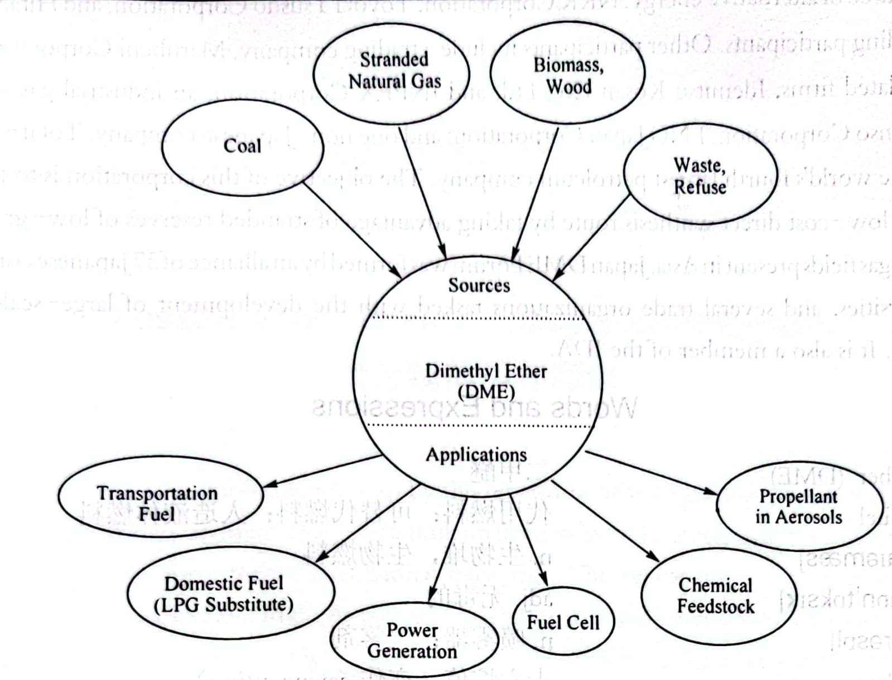
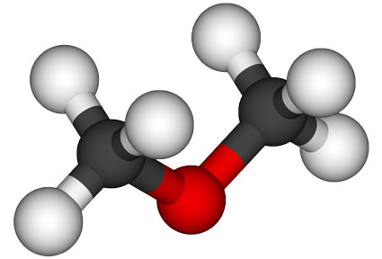

Slide 86
The simplest ether compound, DME has been shown to be both nontoxic and environmentally benign.
Dimethyl ether has a variety of uses in the fuel and the chemical industries.
Currently, the major use of DME is as a propellant in the aerosols industry.
二甲醚是最简单的醚类化合物，已被证明无毒且对环境无害。
二甲醚在燃料和化学工业中有多种用途。
目前，二甲醚的主要用途是作为航空工业中的推进剂。

Slide 87
Its cetane number (a quantitative indicator of the ignition quality of diesel fuel) is high, ranging from 55 to 60, so that it can be used in diesel engines.
Its flame is a visible blue flame similar to that of natural gas, and it can be used just as it is in an LPG cooking stove, and it does not produce any aldehydes.
The toxicity of DME is low, about the same as that of LPG, and even lower than that of methanol.
Because of DME's restrictive use, current world capacity is only 150,000 metric tons/yr.
Future mega-plant technology providers include NKK, Haldor Topsoe, Lurgi, Toyo Engineering, Mitsubishi Gas Chemicals, Kvaerner, Synetix, etc.

Slide 88
它的十六烷值（柴油点火质量的定量指标）很高，在55到60之间，因此可以用于柴油发动机。
它的火焰是一种类似于天然气的可见蓝色火焰，可以像在液化石油气烹饪炉中一样使用，而且不会产生任何醛。二甲醚的毒性较低，与液化石油气的毒性大致相同，甚至低于甲醇的毒性。
由于二甲醚的使用受到限制，目前世界产能仅为150000公吨/年。
未来的大型工厂技术供应商包括NKK、Haldor Topsoe、Lurgi、Toyo Engineering、Mitsubishi Gas Chemicals、Kvaerner、Synetix等。

Slide 89
There have been a number of joint efforts between companies at a multinational level to gather and disseminate know-how about DME properties, DME synthesis processes, and DME applications.
These associations have furthered DME's cause by jointly conducting testing studies on DME applications as an automotive fuel, an LPG substitute, and a fuel for power generation.
The International DME Association (IDA) plays a significant role in enhancing knowledge about DME to the general public and is a central source of comprehensive DME related information (www.aboutdme.org).
Institutional members of this association include BP, Carbinol Technologies, AVL Powertrain Engineering, Inc., Air Products, Renzult, Snamprogetti, Lurgi, Akzo Nobel, Shell Global Solutions, Haldor Topsoe, Volvo,Atrax Energi AB, Mitsui, Japan DME Forum (JDF), etc.

Slide 90
跨国公司之间开展了一系列合作，以收集和传播有关DME性能、DME合成工艺和DME应用的专业知识。
这些协会通过联合对二甲醚作为汽车燃料、液化石油气替代品和发电燃料的应用进行测试研究，进一步推动了二甲醚的事业。
国际DME协会（IDA）在提高公众对DME的认识方面发挥着重要作用，是全面DME相关信息的中心来源（www.aboutdme.org）。
该协会的机构成员包括英国石油公司、Carbinol Technologies、AVL动力总成工程公司、股份有限公司、Air Products、Renzult、Snamprogetti、Lurgi、Akzo Nobel、壳牌全球解决方案公司、，Haldor Topsoe、沃尔沃、Atrax Energi AB、三井物产、日本DME论坛（JDF）等。

Slide 91

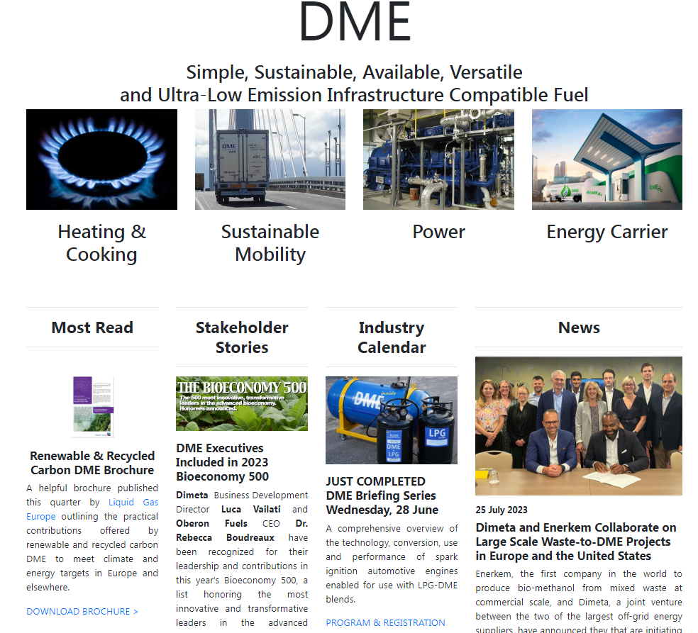

Slide 92
It is an excellent source of comprehensive information about DME synthesis, applications of DME as a fuel in various sectors, as well as the economic, environmental, and commercial aspects of DME utilization.
DME International Corporation was established in Tokyo and Japan by a consortium of eight companies to commercialize and market DME as a new source of alternative energy.
NKK Corporation, Toyota Tsusho Corporation, and Hitachi,Ltd. are the leading participants. Other participants include a trading company, Marubeni Corporation; two energy-related firms, Idemitsu Kosan Co., Ltd.and INNPEX Corporation; an industrial gas supplier, Nippon Sanso Corporation; LNG Japan Corporation; and one non-Japanese company, Total-FinaElf, which is the world's fourth largest petroleum company.

Slide 93
它是有关二甲醚合成、二甲醚作为燃料在各个领域的应用以及二甲醚利用的经济、环境和商业方面的综合信息的极好来源。
DME国际公司由八家公司组成的财团在东京和日本成立，旨在将DME作为一种新的替代能源进行商业化和营销。
NKK公司、丰田Tsusho公司和日立有限公司是主要参与者。其他参与者包括贸易公司丸红株式会社；两家能源相关公司，Idemitsu Kosan有限公司和INNPEX公司；工业天然气供应商日本三生株式会社；液化天然气日本公司；以及一家非日本公司Total FinaElf，它是世界第四大石油公司。

Slide 94
The objective of this corporation is to produce DME by a low-cost direct synthesis route by taking advantage of stranded reserves of low-grade coal and smaller gas fields present in Asia.
Japan DME Forum was formed by an alliance of 37 Japanese companies, two universities, and several trade organizations tasked with the development of large-scale DME technology. It is also a member of the IDA.
该公司的目标是利用亚洲低品位煤和较小气田的滞留储量，通过低成本的直接合成路线生产二甲醚。
日本DME论坛由37家日本公司、2所大学和几个负责开发大规模DME技术的贸易组织组成。它也是国际开发协会IDA的成员。

